Slide 1
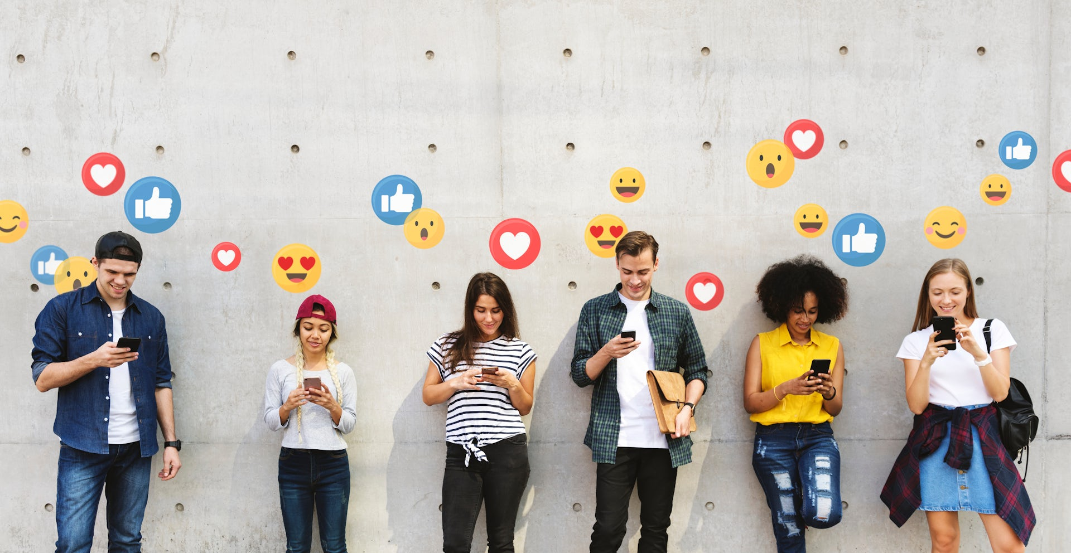
The Power of Influencers on Social Media

Slide 2




Content: - Impact of Influencers - Reasons for Influencer Research - User Utilization and destination of Influencer Information - Data analytics - Data Visualization

Slide 3





Impact of Influencers
03
Business Collaborations
Influencers often collaborate with brands, leading to mutually beneficial partnerships that enhance brand visibility and credibility.
01
Consumer Behavior
Influencers have the ability to sway consumer behavior, driving purchase decisions and shaping trends through their endorsements and product recommendations.
02 Social Causes
Many influencers leverage their platform to advocate for social causes, raising awareness and mobilizing support for important issues.

Slide 4


Reasons for Influencer Research
Relevance in Digital Marketing
Growth of Influencer Marketing
Diversity of Platforms
Available Data

Slide 5

User Utilization and destination of Influencer Information
User Utilization:
Purchase Decision-Making
Content Discovery
Inspiration and Entertainment
Destination of Information:
Following Relevant Influencers
Interaction and Feedback
User-Generated Content Creation

Slide 6
Data analytics - Data Visualization

Slide 7
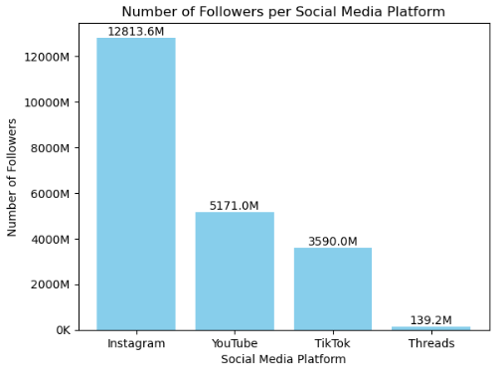

Chart Analysis
In this graph we can see the total number of followers that each social network has according to the top 100. Clearly Instagram is positioned as the leader.

Slide 8
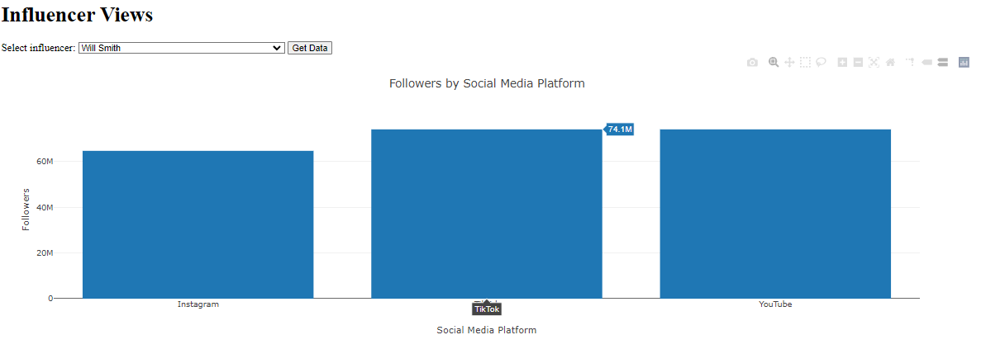
Followers by Social Media Platform

Slide 9
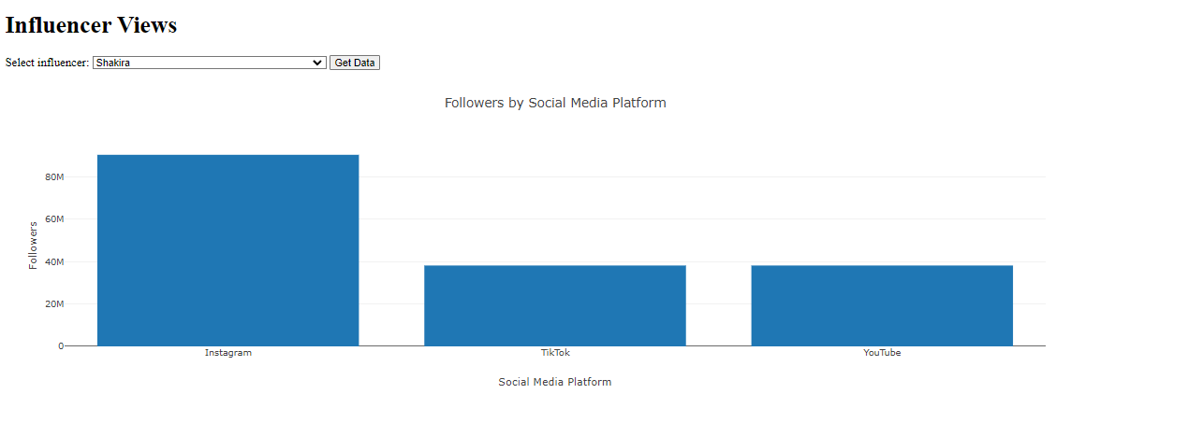

Slide 10

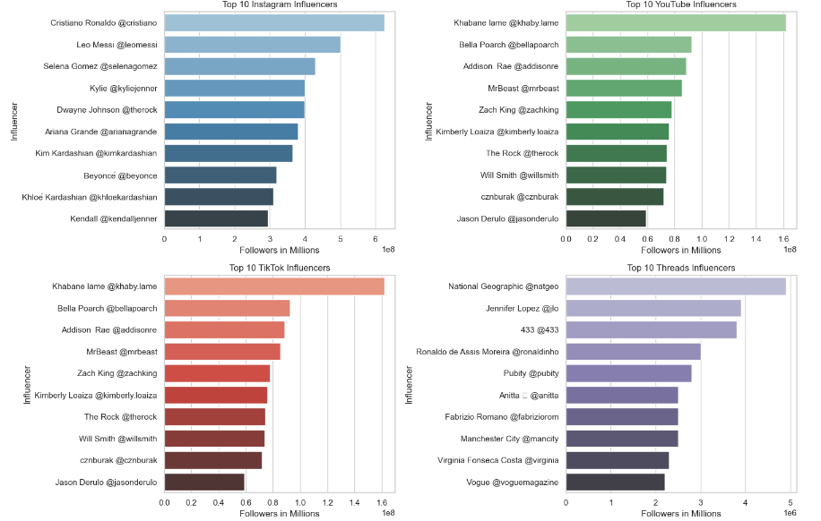

Top 10 influencers for each platform
Seaborn is a Python data visualization library based on matplotlib.

Slide 11
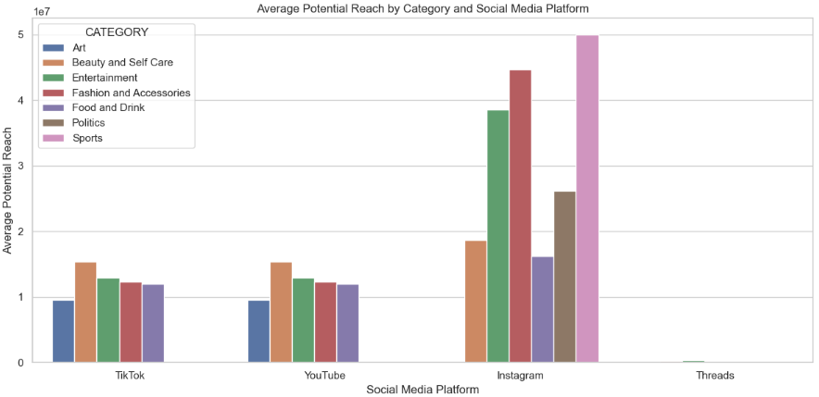
Group by Category and Social Media Platform calculate Average potential reach

Slide 12

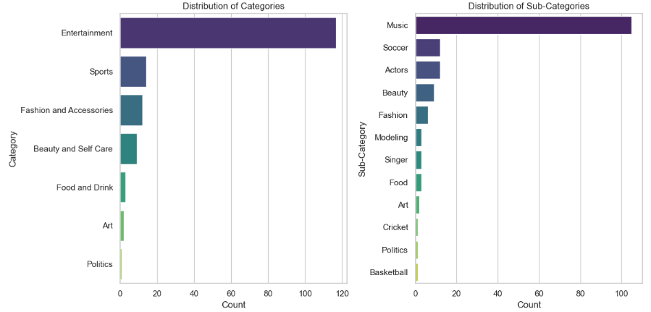
Distribution of each category

Slide 13
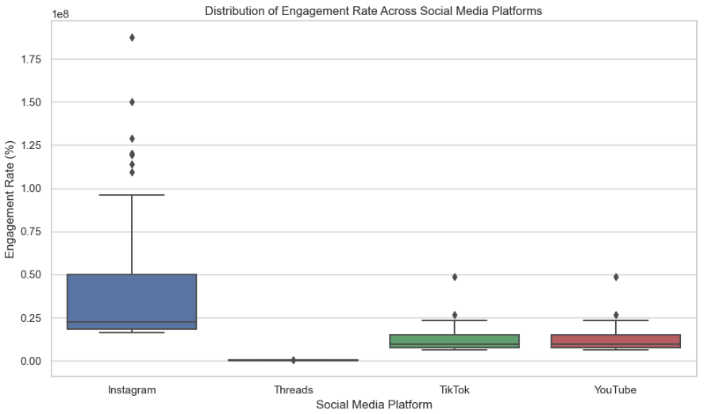
Distribution of Engagement Rate Across Social Media Platforms

Slide 14
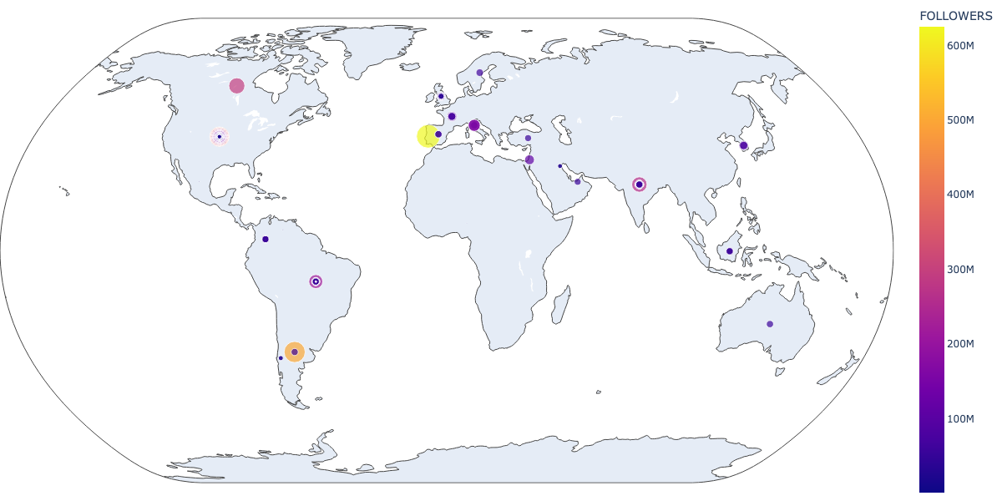
Map based on followers count world map

Slide 15
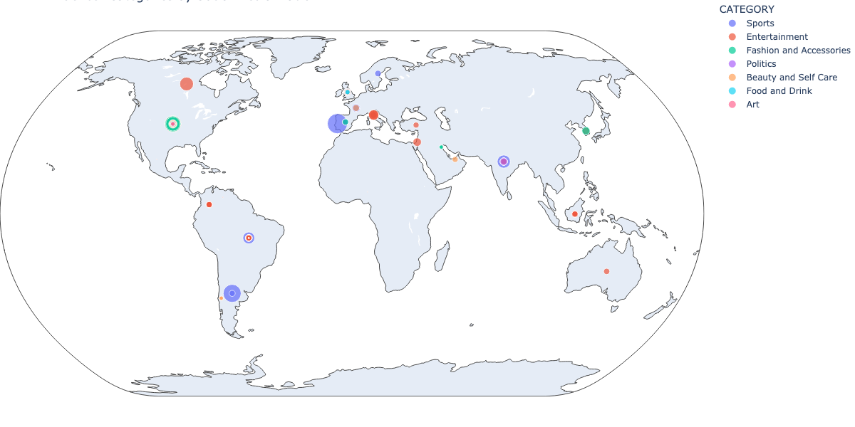
Map based on Categories by social media platform with potential reach engagement rate

Slide 16
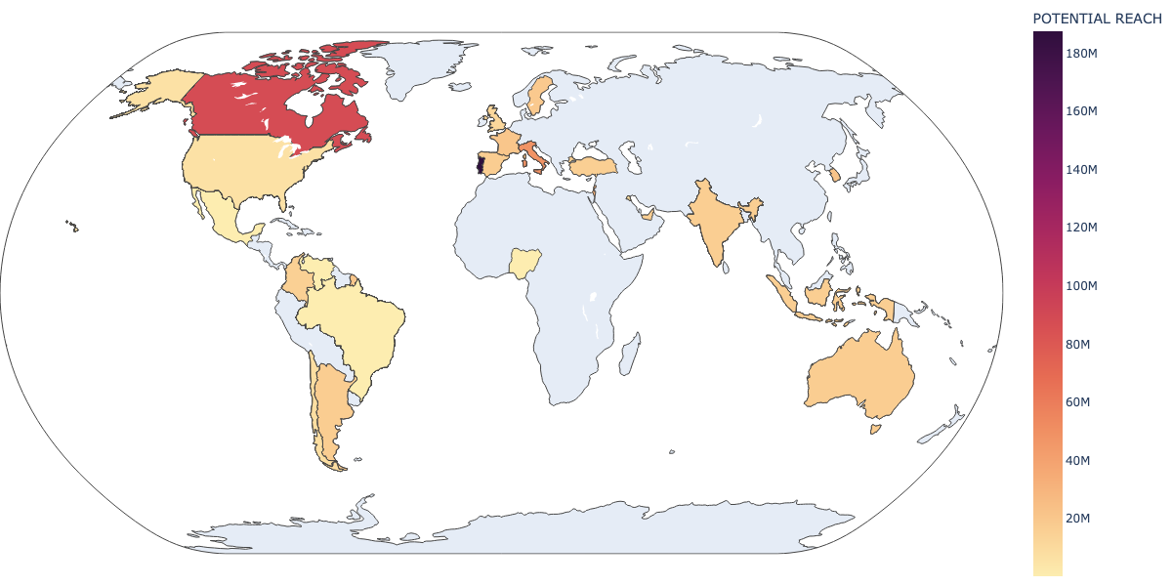
Potential Reach World Map

Slide 17
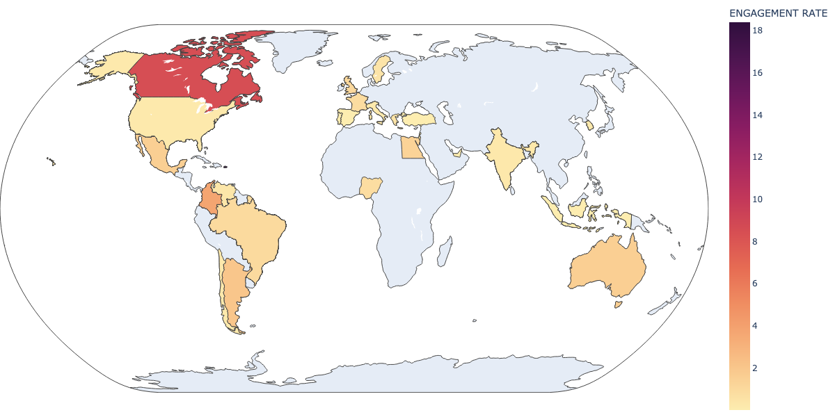
Engagement Rate World Map

Slide 18





THANK YOU
Q & A

